Slide 1
Error Stability vs. Point-wise Stability

Slide 2
Good Old Hypothesis Testing
Goal: prove that drug X is effective in preventing heart attacks
Effect size: taking the drug daily prevents 20% of heart attacks.
Statistical significance: The probability of observed improvement assuming the the effect is smaller than 20%.
Eliatoric -- Inherent, effect size, calibration, does not depend on data size.
Epistemic -- regarding knowledge of the effect. Statistical significance, Improves with data size.

Slide 3



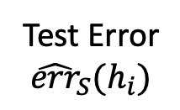
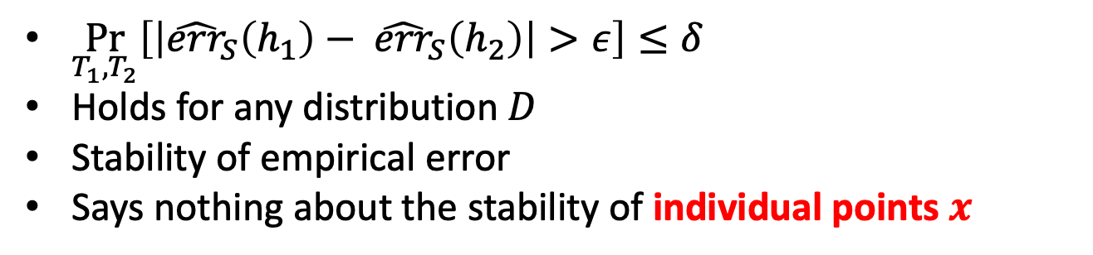




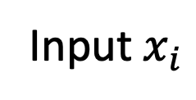

Error Stability
Distribution $D$
Fix concept class $H$ with finite Capacity (VC Dimension)
Input$x_{i}$
Label $y_{i}$
Training set $T_{1}$
Training set $T_{2}$
Training data
IID
Learning algorithm
(ERM)
Classifier $∈H$
Test set $S$
$$h_{1}∈H$$
$$h_{2}∈H$$
$\underset{T_{1},T_{2}}{Pr}\left[\left|{\hat{err}}_{S}\left(h_{1}\right)− {\hat{err}}_{S}\left(h_{2}\right)\right|>ε\right]≤δ$
Holds for any distribution $D$
Stability of empirical error
Says nothing about the stability of individual points $x$
Test Error
$${\hat{err}}_{S}(h_{i})$$

Slide 4
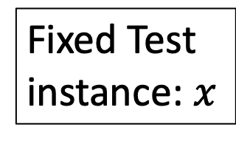
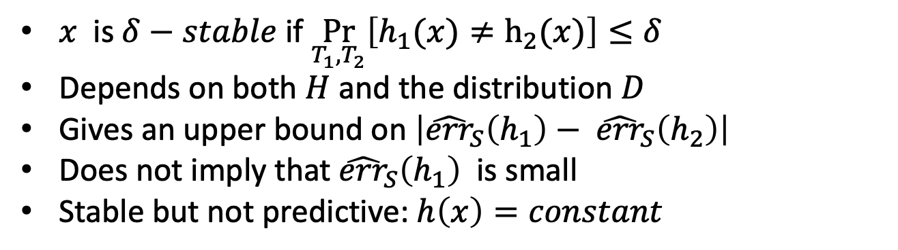

General Pointwise Stability
Distribution $D$
Input$x_{i}$
Label $y_{i}$
Training set $T_{1}$
Training set $T_{2}$
Fixed Test instance: $x$
Training data
IID
Learning algorithm
(ERM)
Classifier $∈H$
$$h_{1}∈H$$
$$h_{2}∈H$$
$$h_{1}\left(x\right),h_{2}\left(x\right)$$
$x$ is $δ−stable$ if $\underset{T_{1},T_{2}}{Pr}\left[h_{1}(x)≠h_{2}(x)\right]≤δ$
Depends on both $H$ and the distribution $D$
Gives an upper bound on $\left|{\hat{err}}_{S}\left(h_{1}\right)− {\hat{err}}_{S}\left(h_{2}\right)\right|$
Does not imply that ${\hat{err}}_{S}\left(h_{1}\right)$ is small
Stable but not predictive: $h\left(x\right)=constant$

Slide 5


TLDR2: Margins and confidence
Find linear classifier with large margin
Large margin implies there is a cone of linear classifiers with close-to-minimal error.
Large margin test examples are classified identically by classifiers in cone.
The prediction on large margin test examples is insensitive to small changes in training set.
?
?
?
?
?
?
?
?
?
?
?

Slide 6
Stability wrt other perturbations
Perturbing the data
margins: replacing the training set.
Bootstrap: approx. replacing dataset when data is limited.
Bagging / random forests.
Adding noise to the training data.
Getting data from different sources.
Perturbing the algorithm:
Varying the model: NN architecture, depth of decition trees, number of features.
Combining completely different algorithms: NN, Boosting, KNN, decision trees
Perturbing the input:
Adding noise (random, adversarial)
Transforming (for images: rotation, translation, scaling,…)

Slide 7
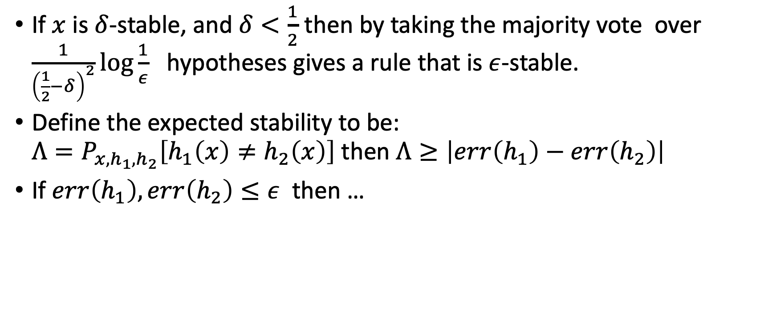

Some properties of $δ$-stability
If $x$ is $δ$-stable, and $δ<\frac{1}{2}$ then by taking the majority vote over $\frac{1}{{\left(\frac{1}{2}−δ\right)}^{2}}\log{\frac{1}{ε}}$ hypotheses gives a rule that is $ε$-stable.
Define the expected stability to be: ${Λ=P}_{x,h_{1},h_{2}}\left[h_{1}\left(x\right)≠h_{2}\left(x\right)\right]$then $Λ≥\left|err\left(h_{1}\right)−err\left(h_{2}\right)\right|$
If $err\left(h_{1}\right),err\left(h_{2}\right)≤ε$ then …

Slide 8
Detection cascade

